Slide 1
Fujitsu Laboratories of America (FLA) & The Platypus Institute (TPI) (Goal: Demonstration of Neurocognitive Capabilities)
Some Key points:
---Executive functions (information processing, sequencing, decision making, planning) are associated with employee performance and success
---The Principles of Brain Plasticity incorporated by TPI provide a scalable solution to evaluate and develop executive functions, functions that are malleable throughout childhood and adolescence.
---Training and interventions demonstrate some success, but there is limited evidence that gains transfer due to a lack of independent evaluations

Slide 2
Calculating Cognitive Efficiency
The following slides compare FLA employees based on their Cognitive Efficiency for various tasks.
Cognitive Efficiency is a combined measure of both speed and accuracy that essentially quantifies an individual’s capacity to make correct responses per minute on a given task. It is the ideal measure to use when comparing individuals on the same task.

Slide 3
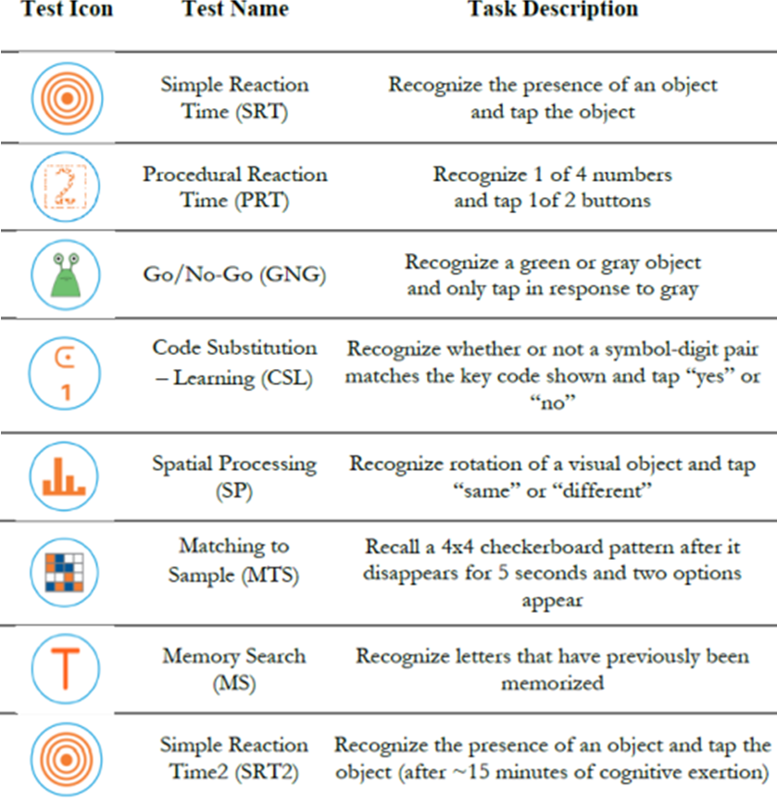
List of Neurocognitive Batteries Administered

Slide 4
Pre-Brain Training Measurement
22 participants, 11 males and 11 females
Attrition – 1 male subject was discontinued from the study since they were unavailable for follow-up testing (offsite employee).
Brain training data (hours of training) were used to split the group into half.
Tier 1 group was comprised of 4 male and 6 female participants.
Tier 2 group was comprised of 6 males and 5 female participants
The following 4 slides show that the no statistically significant differences were identified between the two groups on the pre-brain training measures.
Note: The pre-brain training measures show a comparison to a 3rd group (a military cohort) for comparison and indicated by the gray bars.

Slide 5
Pre-Training Serial Reaction Time 1 and Time 2
Note: Higher bars are better (faster accurate decision making) and the 2 FLA tiers are not statistically different.
Interestingly, the FLA groups perform significantly lower in comparison to military personnel on simple motor task measuring reaction time.
Notes:
Tom T – drop off at time 2 suggests either fatigue, loss of focus or poor task compliance.

Slide 6
Pre-Training Procedural Reaction Time and Go/No-Go
Note: Higher bars are better (faster accurate decision making) and the 2 FLA tiers are not statistically different.
Interestingly, the FLA groups perform better compared to military personnel on a Go/No-Go decision making task.
Notes:
Tom T – no issues in vigilance or procedural RT, higher performance than Military and consistent with team

Slide 7
Pre-Training Memory Recognition & Recall
Note: Higher bars are better (faster accurate decision making) and the 2 FLA tiers are not statistically different.
Interestingly, the FLA groups perform better compared to military personnel on a memory matching task but not a memory search task .

Slide 8
Pre-Training Task Performance by Brain Training Tier
Note: Summary slide showing all three groups compared prior to brain training.

Slide 9
Brain Training Goals
Demonstrate the capability for the deployment of on-line brain training for FLA employees to build cognitive capacity.
Targeted Training Areas:
Brain Speed
Attention
People Skills
Intelligence
Training Goals:
A range of 20 training Sessions, each session for 30 minutes over a 6 week period.
Incentives were created for individuals reaching 30 training hours.
Tier 1 and Tier 2 designation
A median split based on training was performed to compared the impact of brain training on an independent measure of neurocognitive performance, shown in previous slides

Slide 10
Brain Training (Groups Identified Based on Training Amount)
 | FLA-Tier 1 | FLA-Tier 2
# of Subjects | 10 | 11
Hours Trained (Range) | 17-45 | 1-14
Days Trained (Average) | 40 | 23
Hours Trained (Average) | 30 | 7
Training Levels Achieved (Average) | 824 | 201
Age (Average) | 43.8 | 40.9

Slide 11
Brain Training: Training Days by Individual
Days
Note: the majority (16 of the 21 individuals) trained a minimum of 20 sessions with a group average of 31 sessions.

Slide 12
Brain Training Improvements Identified for Both the Higher and Lower Training Group
Note: Higher bars are better, Tier1 individuals who trained more hours showed more growth on the training exercises and performed 7 percentage points higher overall with measured gains in Attention, Brain Speed and People Skills. Performance on the Intelligence tasks were not statically difference across the two training groups.

Slide 13
Post-Brain Training Results on Independent Neurocognitive Measures

Slide 14
Pre- and Post-Brain Training Overall Cognitive Efficiency (FLA-Tier 1 vs FLA-Tier 2)
Note: Higher bars are better, cognitive efficiency across all 8 independent neurocognitive measures shows that Tier1 individuals see twice the improvement following training as did the Tier 2 group who trained for fewer hours. These results interacted with task and will be discussed in the following slides.
Notes:
Tom T – drop off at time 2 suggests either fatigue, loss of focus or poor task compliance.

Slide 15
Post-Brain Training Serial Reaction Time 1 and Time 2
Note: Higher bars are better, Tier1 individuals who trained for more hours showed higher performance on the independent measures of reaction time as compared to the Tier-2 group. These differences were present on at the beginning and end of the evaluation as indicate on Simple Reaction Time 1 and Time2, respectively. Performance fatigue did not appear to play a role during the evaluation.
Notes:
Tom T – drop off at time 2 suggests either fatigue, loss of focus or poor task compliance.

Slide 16
Post Brain Training Procedural Reaction Time and Go/No-Go
Note: Higher bars are better, Tier1 individuals who trained more hours showed a higher level of performance on these measures of perceptual discrimination and impulse control.
Notes:
Tom T – no issues in vigilance or procedural RT, higher performance than Military and consistent with team

Slide 17
Post-Brain Training Memory Recognition & Recall
Note: Higher bars are better, Tier1 individuals who trained more hours showed a higher level of performance on these measures of memory search, additional measures of learning, visual spatial processing and memory matching showed similar growth for both Tier 1 and Tier 2 training groups.

Slide 18
Post-Brain Training Task by Group Performance
Note: Higher bars are better. The above information was discussed in the preceding 3 slides.

Slide 19
(Post-Pre) Brain Training Task by Group Performance
Note: Higher bars are better, the performance differences (Post-Pre) by Training Group (Tier 1 and Tier 2) are shown above. Results indicate that 7 of the 8 tasks show greater for the group with more brain training. 6 of the 8 tasks show positive, albeit smaller performance changes, for the group with few brain training.

